Slide 1
RADIO FREQUENCY REMOTE CONTROL
A SEMINAR PROJECT PRESENTED BY
NWANZE FRANKLIN CHUKA
REG NUMBER 2011364033
DEPARTMENT OF
ECE

Slide 2
INTRODUCTION
Radio Frequency Remote control operates by transmitting radio frequency signals from one point to another.
The signals transmitted are in digital form and as such can be easily manipulated.

Slide 3
BASIC COMPONENTS OF RF REMOTE CONTROL
TLP (TRANSMITTER MODULE) 433 AND RLP 433 (RECEIVER MODULE).
MICRO CONTROLLER

Slide 4
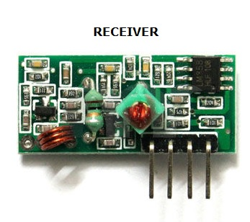
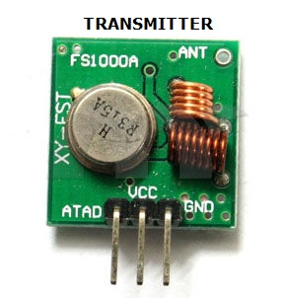
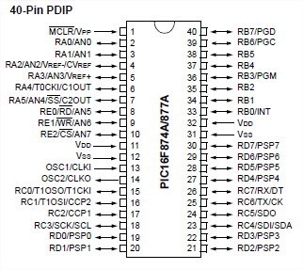
MICRO CONTROLLER PIC 16F877A

Slide 5
RF MODULE SPECIFICATIONS
Technical parameters of the receiver head
Operating voltage : DC5V
Receiving frequency: 433.92MHZ
Receiver sensitivity: - 105DB
Size : 30 * 14 * 7mm
external antenna: 32CM single core wire wound into a spiral
Technical parameters of the transmitter head
Launch distance: 20 -200 meters (different voltage, different results)
Operating voltage: 3.5-12V
Ways of working: AM
transfer rate: 4KB / S
transmit power: 10mW
Transmitting frequency: 433MHZ
Pin out from left → right: ( DATA ; VCC ; GND )

Slide 6
BLOCK DIAGRAM OF RF REMOTE CONTROL
POWER SUPPLY
5V
12V
RF SIGNALS
5V
5V
KEYPAD
MICRO CONTROLLER
TX
RX
MICRO CONTROLLER
ANTENNA
CONTROLLED DEVICE

Slide 7
FUNCTION OF MICRO CONTROLLER IN THE CIRCUIT
The micro controller performs the following functions
Encoding and Decoding
Noise Filtering
Transmitter and Receiver Synchronization
Redundancy check
Action initiation

Slide 8
ENCODING TECHNIQUE (MANCHESTER)
This is an encoding technique where there is a transition from either HIGH to LOW or LOW to HIGH of every bit at equal time.

Slide 9
WHY USE MANCHESTER ENCODING?
On idle state, the receiver module picks up stray radio frequency signals and if care is not taken it can be interpreted as‘1’ or ‘0’.
We use Manchester encoding technique in remote control to help the microcontroller detect when the transmitter is transmitting a long stream of zeros or ones

Slide 10
MANCHESTER ENCODING ILLUSTRATED
1
0
1
0
0
1
0
Diagrammatic representation of bits
1
0
0
1
1
0
0
1
0
1
1
0
0
1
Diagrammatic representation of Manchester encoded bits

Slide 11
TYPE OF IMPLEMENTATION
All these functions of the micro controller are implemented via software by writing a control program to take care of both encoding/decoding, synchronization, redundancy check etc.

Slide 12
THANK YOU

